Slide 1
Poster Evolution from 2014-2021
ML Tlachac

Slide 2
Why am I Presenting About Posters?
18 Posters
Created
8 Projects
12
Presentations
8 Venues

Slide 3
Stage 1: Undergraduate

Slide 4
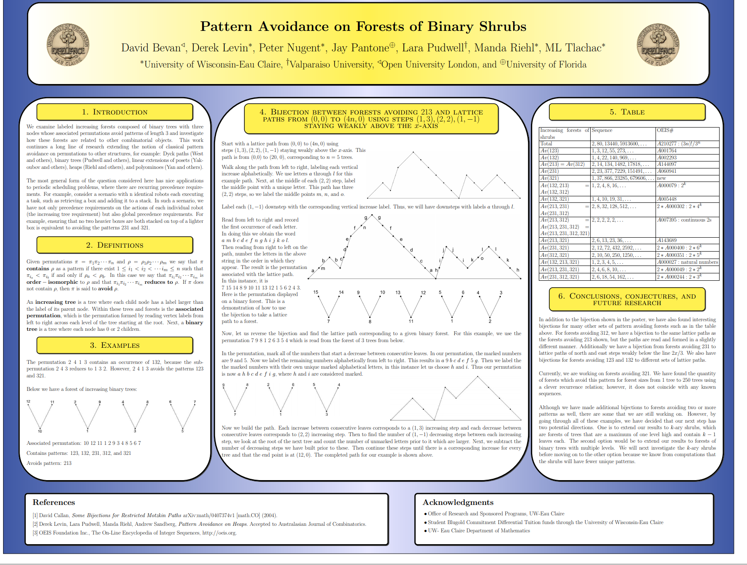
Year: 2015
Tool: Latex

Slide 5
Year: 2015
Tool: Latex
Self Critiques
Too many words
Words too small
Too much future research
Appeals to small audience
Good use of examples with diagrams

Slide 6
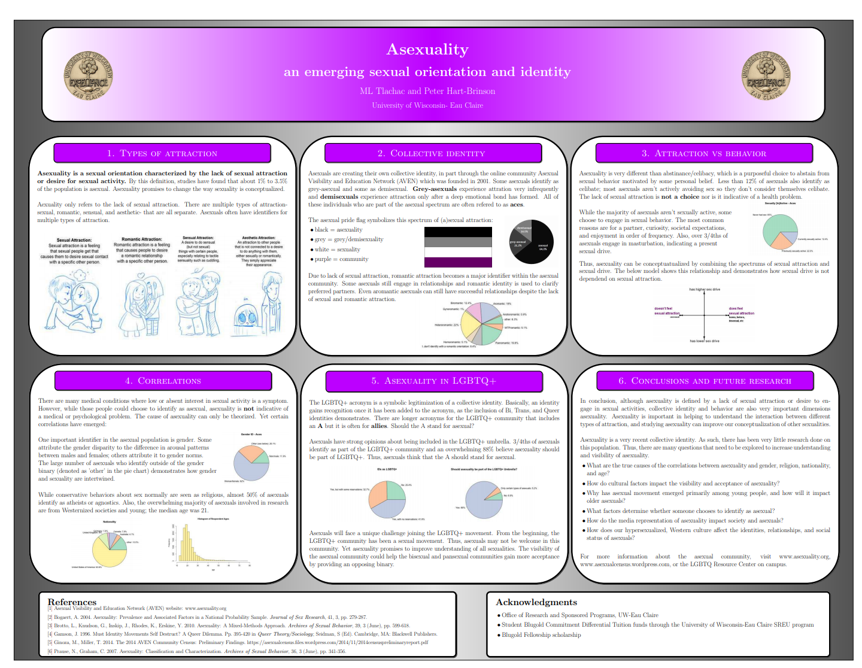
Year: 2015
Tool: Latex

Slide 7

Year: 2015
Tool: PowerPoint

Slide 8
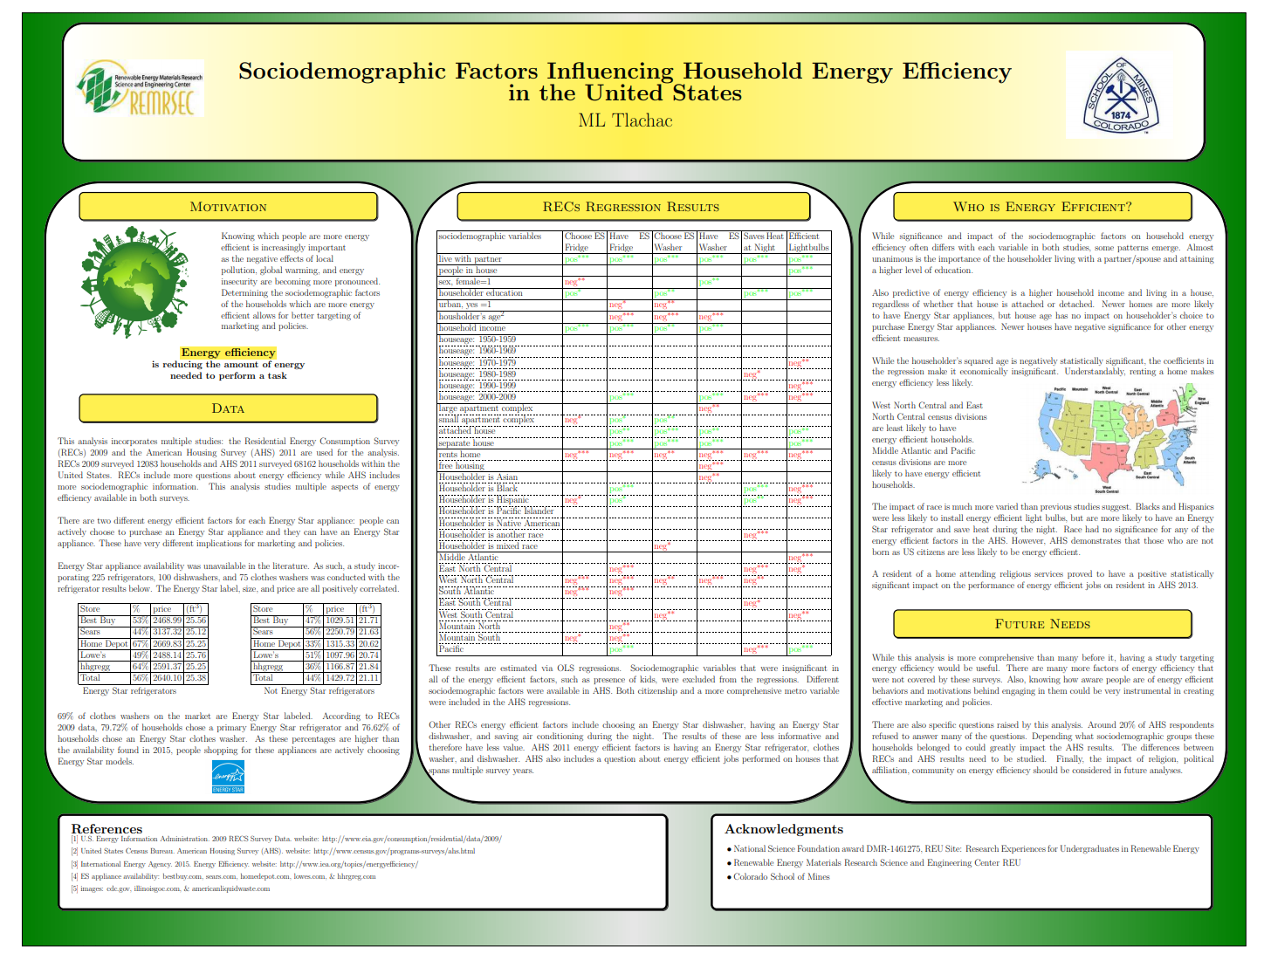
Year: 2015
Tool: Latex

Slide 9
Year: 2015
Tool: Latex
Self Critiques
Colored text in table difficult to read
Too much text
Text too small
Can’t match references
Good use of tables to break up walls of text

Slide 10
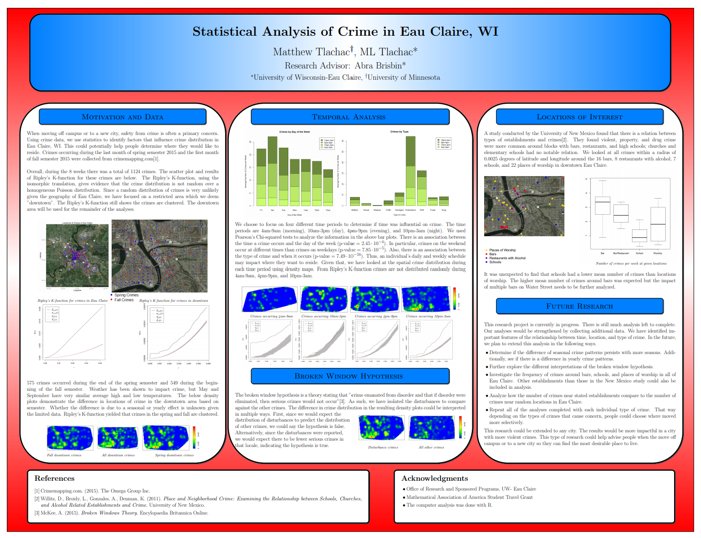
Year: 2015
Tool: Latex

Slide 11
Year: 2015
Tool: Latex
Self Critiques
Bad color choice
Missing header logos
Too much text
Text too small
Too much future research
Good inclusion of visualizations

Slide 12
Stage 2: Early Grad

Slide 13
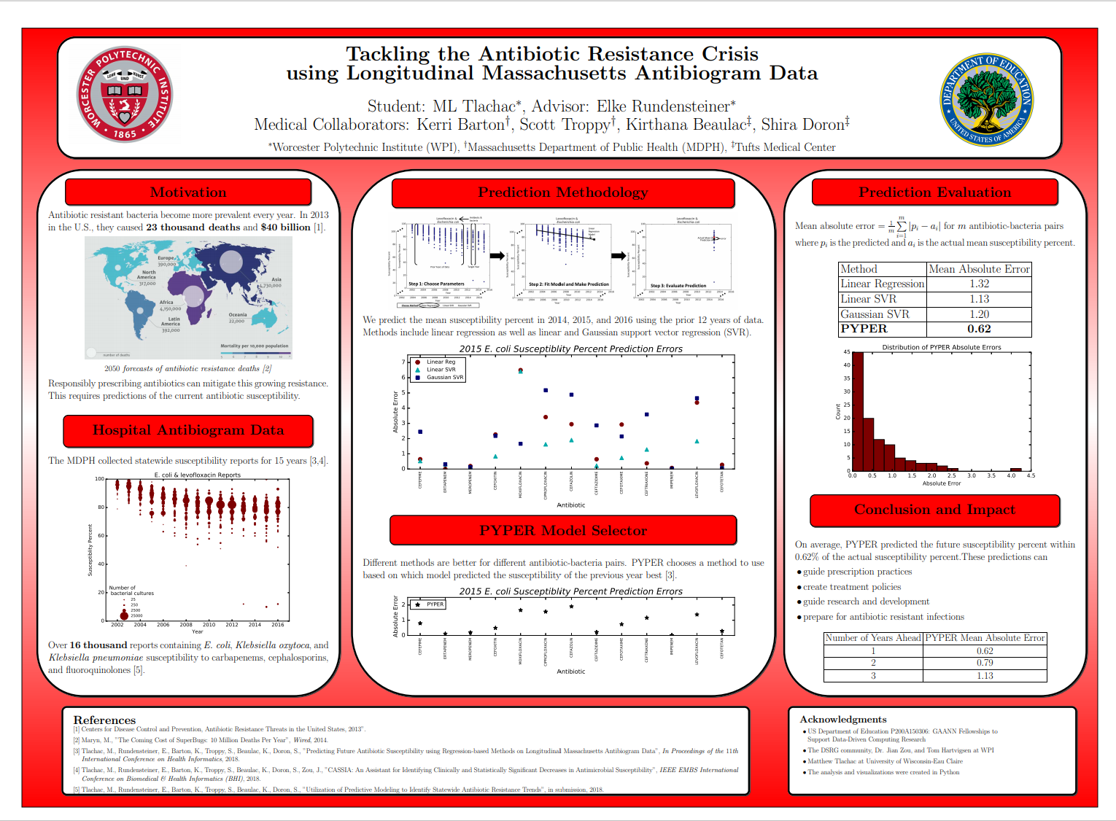
Year: 2018
Tool: Latex

Slide 14
Year: 2018
Tool: Latex
Self Critiques
First figure in middle panel is too small
Good impacts

Slide 15
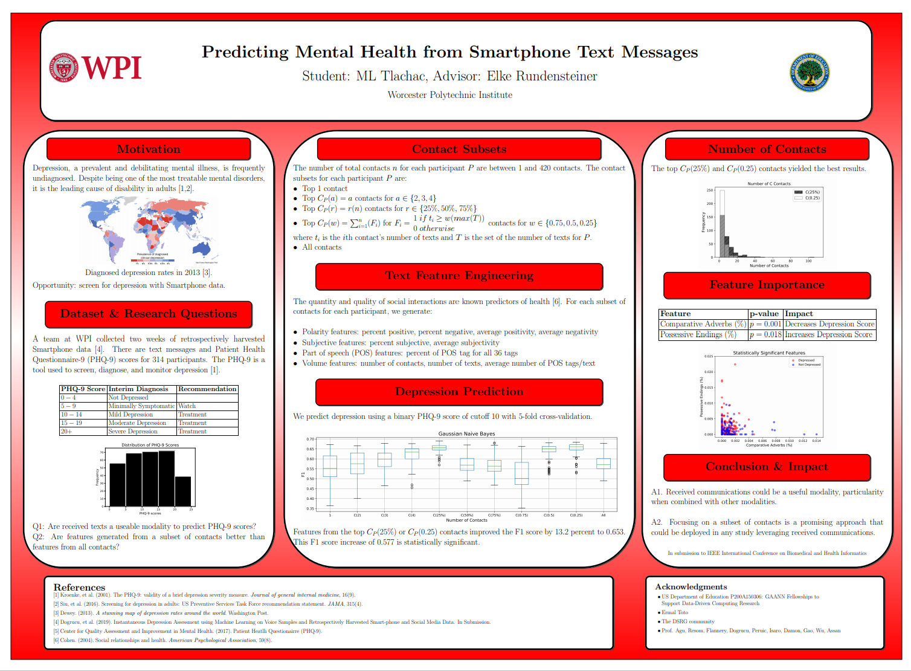
Year: 2019
Tool: Latex

Slide 16
Year: 2019
Tool: Latex
Self Critiques
Not clear Q1 and Q2 correspond to A1 and A2
Not all visualizations work well for a poster
Good use of bullet points

Slide 17
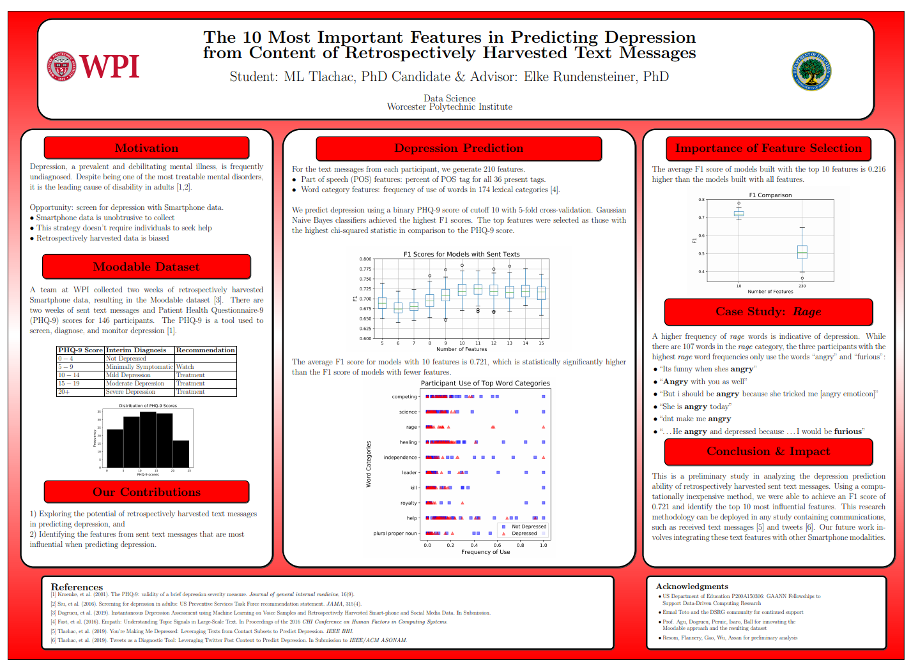
Year: 2019
Tool: Latex

Slide 18
Year: 2019
Tool: Latex
Self Critiques
Empty space
Could highlight most important content, like in case study
Good examples with bolded words

Slide 19
Stage 3: Recent

Slide 20
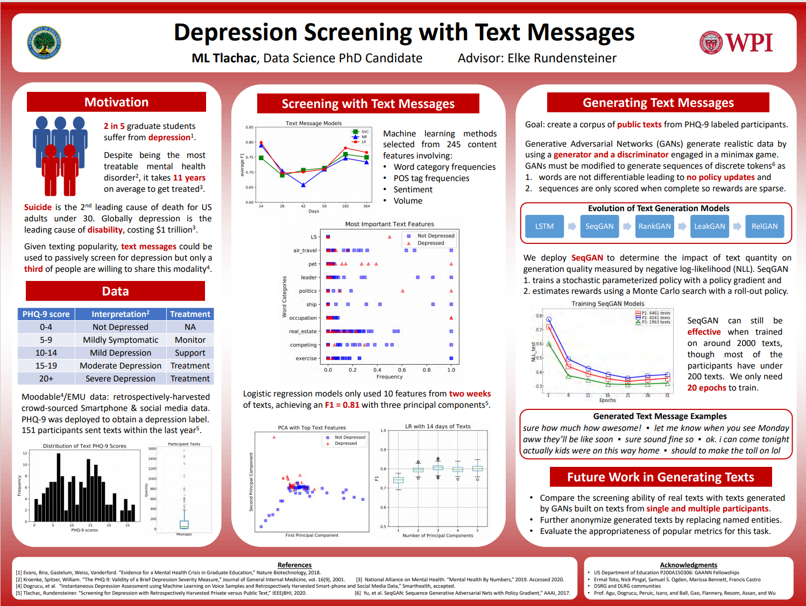
Year: 2020
Tool: PowerPoint

Slide 21
Year: 2020
Tool: PowerPoint
Self Critiques
Story too big for a poster
Why mention future work?
Important words in red
Generated text examples are fun for readers

Slide 22
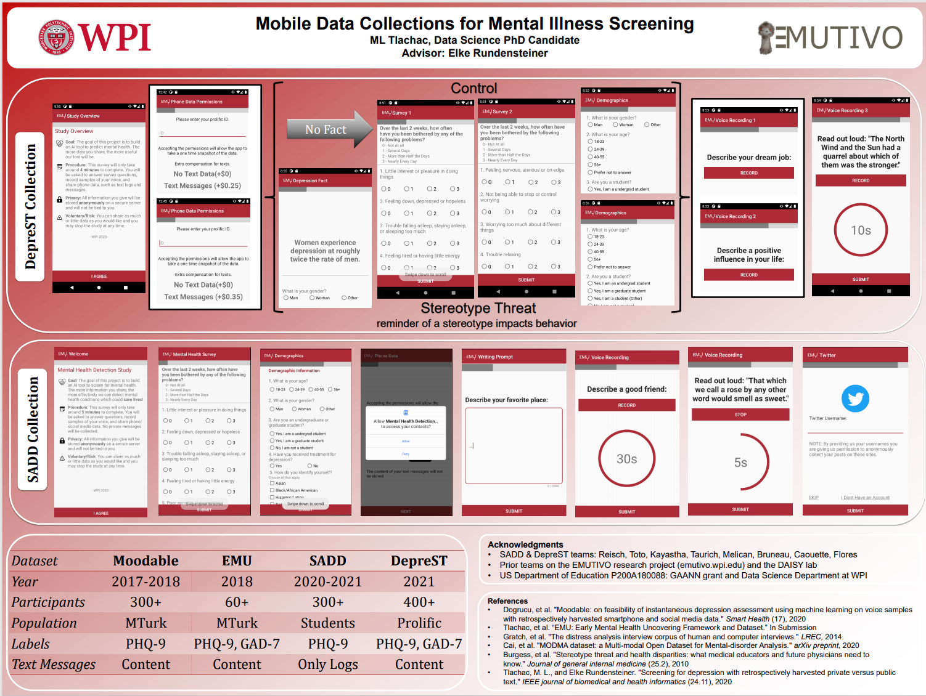
Year: 2021
Tool: PowerPoint

Slide 23
Year: 2021
Tool: PowerPoint
Self Critiques
Can’t read text in screenshots
Can’t match references
No unnecessary words on poster
Visually interesting

Slide 24
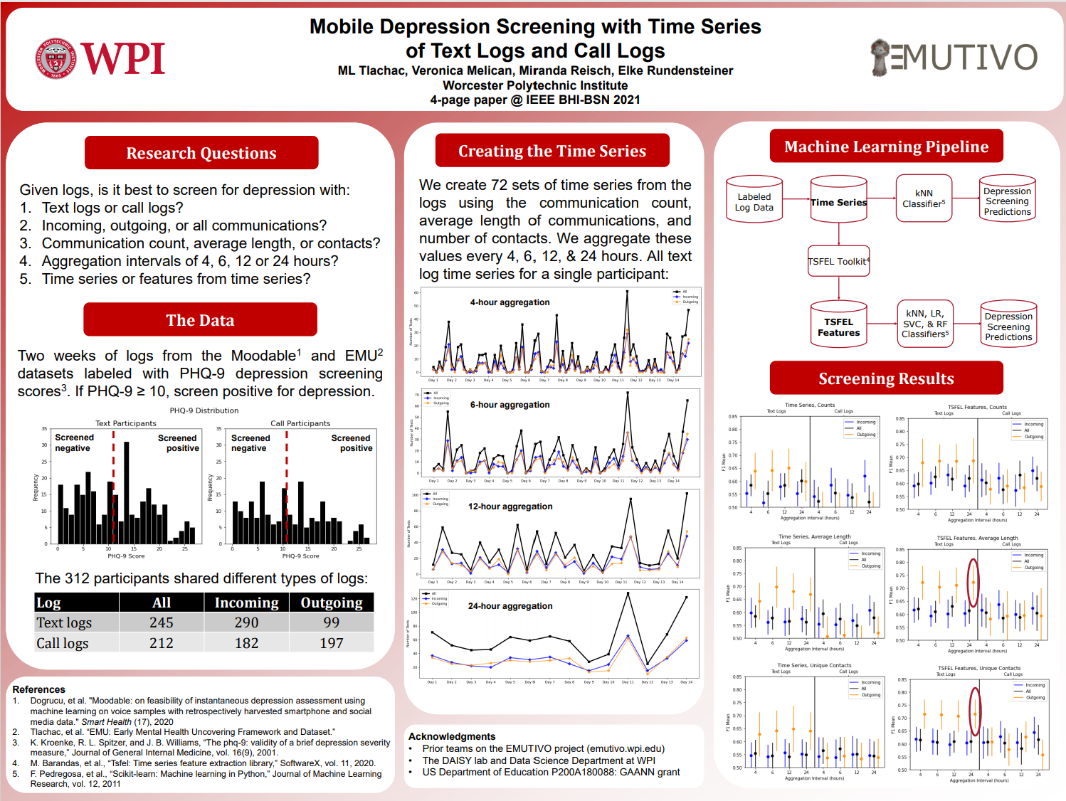
Year: 2021
Tool: PowerPoint

Slide 25
Year: 2021
Tool: PowerPoint
Self Critiques
Colors are unbalanced
Title of result plots are too small to read
Large font
Fun pipeline

Slide 26
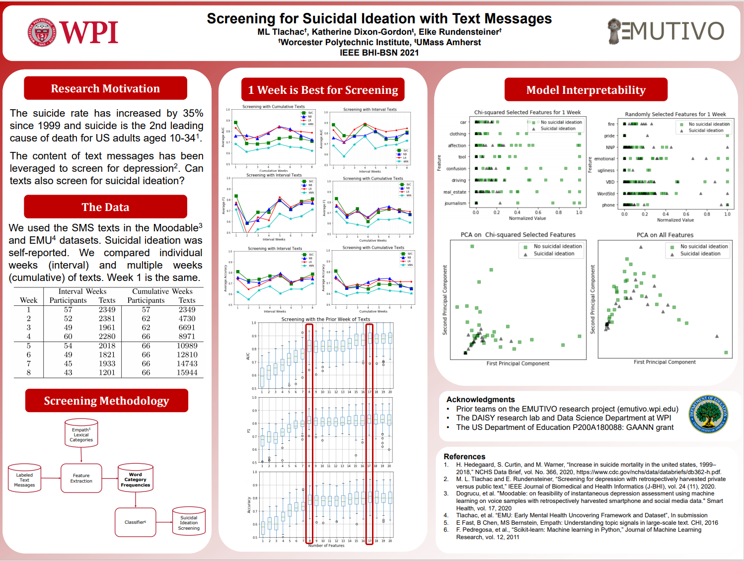
Year: 2021
Tool: PowerPoint

Slide 27
Poster Tips
All Posters
Printed Posters for In-Person
Know your audience
Minimize words
Text big enough to read
Readable text/background colors
Consistent accessible font
Maximize visualizations/tables
High quality images
Make reading order clear
Have an elevator pitch ready
Use a column-based format
Put while panels over colorful background to reduce ink
Include a small white border in case printing misalignment
Have notebook to write suggestions and/or contact info

Slide 28
List of Posters and Venues
Combinatorics at PP, JMM, CERCA (3)
Asexuality at CERCA (1)
Class at CERCA (1)
BIO at CERCA (1)
Stats at JMM (1)
Energy at RMRSEC & JMM (1)
Antibiogram at GRIE (1)
Smartphone at GRIE (1)
10 Features at IEEE BHI (1)
Gen texts at GRIE, Sustainability, WIDS (2)
Data collection at Sustainability (1)
Data collection 1 and 2 at WIDS, Gen at WIDS (3)
Time Series, Screening, and Empath Reddit at IEEE BHI (3)

